Slide 1




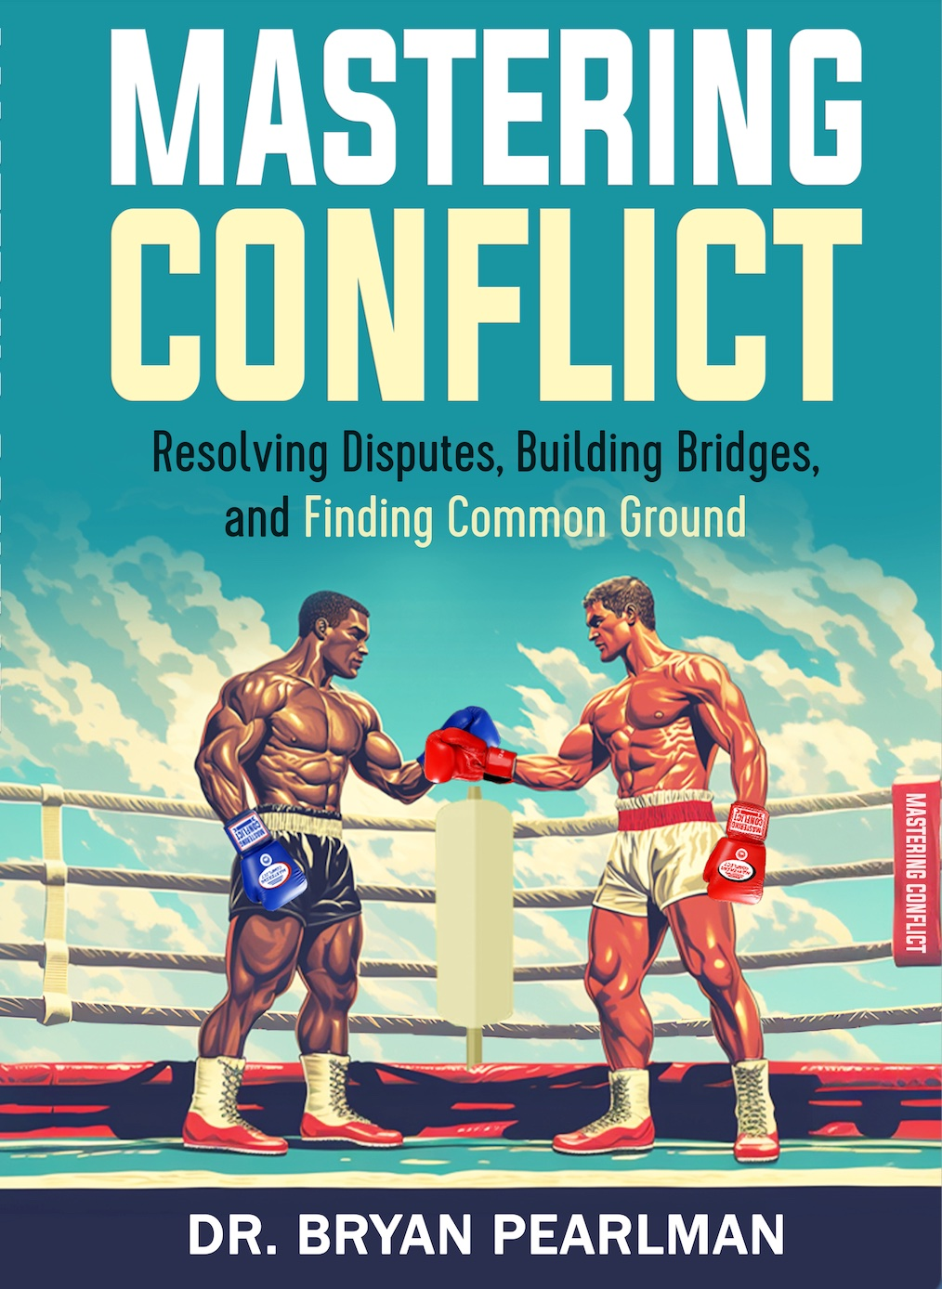
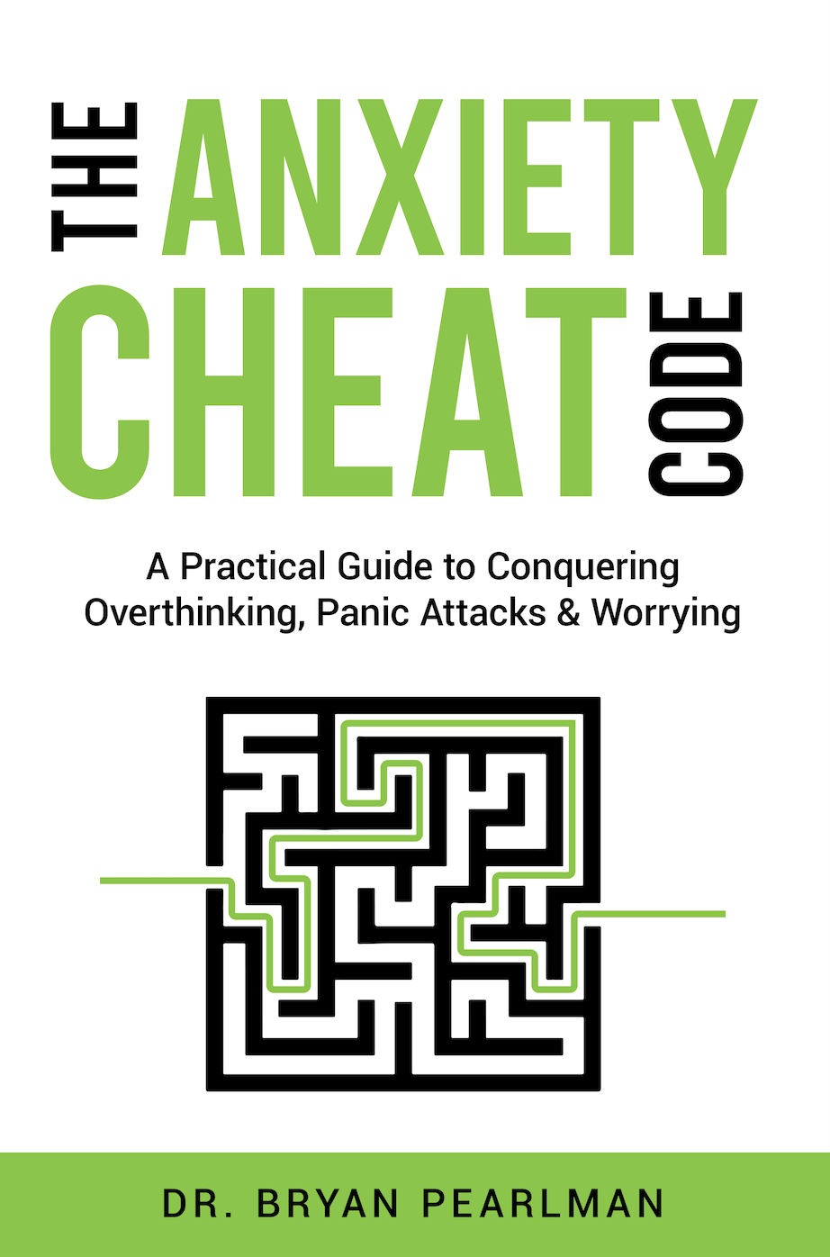


Slide 2

It Is An Honor To Be Here Today!

Slide 3
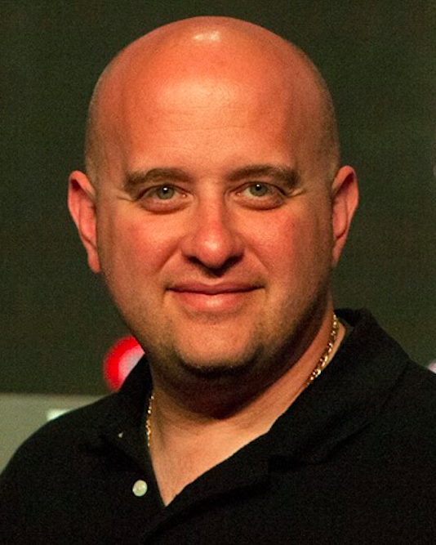



Welcome & Speaker Bio
Bio:
Always AN EDUCATOR first!
Former school principal and teacher
Licensed mental health therapist (MSW)
Keynote speaker & PD Leader
Author of 8 books (2 more on the way in 2025)
Adjunct professor of Ed Psych of the Exceptional Student
On a mission to positively impact 100,000 educators & 1 million students!

Slide 4
What Is Your Why???
For Educators:
Why Do You Stay In This Field?
For Parents/Guardians:
Why Do You Do What You Do – Each/Every Day?

Slide 5


Something To Think About
Bryan is a new student at your school. His file is received and it is really thick. It has a post-it note on it that says “Good Luck With This Kid”.
Your Job: What Mental Health Concerns & Trauma Could Be Present?

Slide 6
A Bit More About Bryan…
Bryan’s file includes all of the following:
-Grandfather died last month unexpectedly
-Recently diagnosed with severe asthma
-Father lost his job recently
-In the nurse’s office frequently
-Easily distracted, appears bored & often off-task
-Poor penmanship & writing skills
-Several Years Behind In Reading
-Not meeting potential
-Difficulty sitting still
-Free/reduced lunch program
-2 grade levels ahead in mathematics (highest math assessment score in district)
-Qualified for the gifted program at a previous school?
-4 schools in the past 6 years (previous schools in Boston, Tampa, New York, Ohio…)
-Both parents work long hours – difficult to reach by phone
-Loves talking about sports and enjoys PE and recess (favorite sport is tennis)
-What Mental Health Concerns Could Be Present? Where Is The Trauma?
-What does he need? How would you help him if he walked into your school today?

Slide 7
Thank you!
Thank you for caring and helping!
This was me about 40 years ago!
This is a big reason why I do what I do to help all students to achieve…
From Struggles to Successes,
Maslow Before Bloom &
Whatever It Takes!!!!

Slide 8
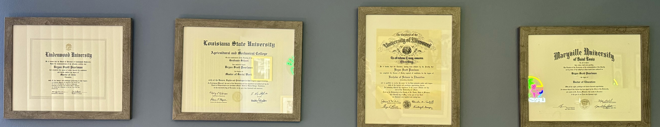
My Why???
“Bryan won’t be college material.”
– Mrs. Mott
(Don’t Be A “Mrs. Mott”)

Slide 9
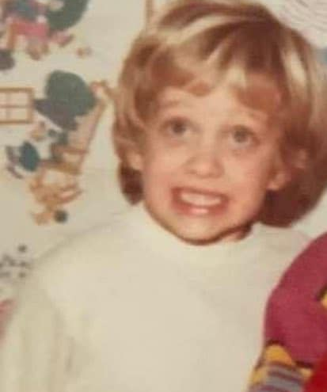
My Why???
“There must be a mistake. How can Bryan be in the gifted program if he can’t read, can’t write, can’t focus and can’t sit still?” -Mrs. Edwards (4th grade teacher)

Slide 10

My Why???
“You may have everyone else in this high school fooled, but I know you’re smart, and I know you can write way better than you did on this paper. Re-write it and come back tomorrow.”
–Ms. Rivers (12th Grade)

Slide 11
My Why???
“Congratulations on your first teaching job! Dad and I are so very proud of you! We know you will never forget what it was like to be a student. Remember the good teachers you had and try to be that person for your students. Remember the teachers who didn’t think you would amount to anything – use that as motivation to help kids who are struggling and those who haven’t experienced success or found their passion yet.
Love, Mom

Slide 12


Slide 13
From Struggles To Successes
"Parenting and teaching take us from struggles to successes—through sleepless nights, tough conversations, and the weight of guiding a child through fear, failure, and self-doubt. But in every hurdle overcome, every tear turned into triumph, and every lesson that sparks growth, we find the greatest reward—knowing we’ve shaped not just a mind, but a heart and a future."

Slide 14
From Struggles to Successes
In classrooms and at kitchen tables, We shape young minds, young hearts enable.
Guiding children through stormy weather, Parents, teachers, thrive together.
Mental health, emotions first, Heal their hearts, quench inner thirst.
Safe and secure, we gently guide, Teach them strength from deep inside.
Social skills, life’s daily needs, Responsibility plants the seeds.
Accountability takes its stand, Life skills taught with steady hand.
Resilience nurtured through mistakes, Every error wisdom makes.
"You win or learn," their mindset grown, From fears and doubts, courage sown.
Boundaries clear and fair defined, Logical rules, gently aligned.
Discipline wise, firm yet kind, Restored relationships refined.
Empathy deep, compassion true, Giving back, their worldview new.
Kindness acts, a volunteer, Character grows, becoming clear.
Words well chosen, bridges made, Active listening foundations laid.
"I feel" statements, compromise, Peaceful solutions, conflicts wise.
Healthy bodies, healthy minds, Balanced screens, wise use refined.
Rest and play, nutrition’s power, Growing stronger hour by hour.
Celebrate each small success, Effort praised, uniqueness blessed.
Self-worth blooms, esteem enhanced, Strength in differences, dreams advanced.
Curiosity’s spark aflame, Learning lifelong, endless game.
Questions welcomed, boredom’s art, Creativity ignites the heart.
Partnership strong, community tight, Parents, teachers, shared insight.
Meetings weekly, voices blend, Support unending, trust extends.
With love and wisdom intertwined, Struggles fade, bright futures shine.
Resilient hearts, minds set free, From struggles to successes be.

Slide 15
Key Points from From Struggles to Successes: A Handbook for Parents & Educators
Effective Communication and Collaboration: Building strong relationships with children and teens requires active listening, compromise, and creating win-win solutions that empower mutual understanding and respect. (Chapter 12)
Learning Through Natural Consequences: Guiding children to learn from their mistakes helps them develop accountability and problem-solving skills while fostering independence and self-confidence. (Chapter 13)
Navigating the Digital Age: Setting boundaries and promoting safe technology use while addressing FOMO (fear of missing out) ensures a balanced and healthy approach to the online world. (Chapter 15)
Promoting Autonomy and Accountability: Gradually providing children with independence while holding them accountable for their responsibilities helps them develop essential life skills and resilience. (Chapter 18)
Building Emotional Regulation: Teaching distress tolerance, impulse control, patience, and self-control equips children with tools to handle challenges and make thoughtful decisions. (Chapter 28)
The Value of Boredom: Embracing boredom as an opportunity to foster creativity and curiosity encourages children to explore new ideas and develop intrinsic motivation. (Chapter 43)

Slide 16
Key Points from From Struggles to Successes: A Handbook for Parents & Educators
Assuming Goodwill and Positive Intent: Approaching interactions with empathy and an assumption of good intentions strengthens trust and promotes meaningful relationships. (Chapter 46)
The Power of Family Meetings: Weekly family meetings create a safe space for open communication, problem-solving, and celebrating successes together. (Chapter 47)
Staying in Touch with the Child Within: Remembering what it’s like to be a child fosters empathy and connection, making it easier to guide and support children. (Chapter 49)
Empowering Emotional Expression: Teaching children to articulate their emotions using "I feel" statements supports emotional literacy and strengthens communication and conflict resolution skills. (Chapter 50)
The Power of Pause: Encouraging teens and parents to pause during moments of conflict helps regulate emotions, reduces tension, and opens the door for constructive conversations. (Chapter 63)
Thinking Like a Mediator: Shifting the focus from "winning" arguments to finding collaborative solutions helps resolve conflicts and strengthen relationships. (Chapter 66)
Embracing Change: Challenging the mindset of "We've always done it this way" encourages growth and innovation, allowing parents and educators to better meet the needs of children in an ever-changing world. (Chapter 69)

Slide 17
What Would You Do?

Slide 18
What Would You Do? – Scenario 1
Situation: Your 14-year-old spends all day in their room on their phone or computer, refusing to come out to engage with the family or do anything active. Attempts to encourage them to join the family for meals or outings have been ignored, and you’re concerned about their well-being.

Slide 19
What Would You Do?
Possible Answers:
A: Remove their screen access until they spend a certain amount of time outside their room.
B: Sit down with them to understand why they are isolating and collaboratively create a plan for screen time and family engagement.
C: Schedule mandatory family time or outings without consulting them.
D: Ignore the behavior and hope they eventually get bored and come out.

Slide 20
What Would You Do?
Best Answer: B. Sit down with them to understand why they are isolating and collaboratively create a plan for screen time and family engagement.
Reason:
This approach balances understanding their feelings and circumstances with guiding them toward healthier habits. Isolation and excessive screen use may be symptoms of stress, anxiety, or other challenges. By engaging them in a collaborative conversation, you foster trust, teach problem-solving skills, and show that their perspective matters. This trauma-informed, restorative, and skill-building approach creates an opportunity to address underlying issues while establishing reasonable boundaries.

Slide 21
What Would You Do?
Collaborative Problem-Solving Lens:
Parent: “I’ve noticed you’re spending a lot of time in your room lately. Can we talk about what’s going on and why it feels better to stay in there? Let’s figure out together how we can balance things so you feel good but also get some time with the family.”
Teen: “I just feel like being alone. It’s easier.”
Parent: “That makes sense. Sometimes being alone feels safe. Let’s brainstorm small ways we can balance alone time with other things, like dinner with the family or a walk outside.”

Slide 22
What Would You Do?
Love and Logic Lens:
Parent: “It’s okay to need space, but spending all day on screens can be tough on your body and mind. How about we figure out a plan together? For example, you could choose when to spend some time with the family or go outside. You’ll feel better, and the screens will still be there after.”
Teen: “I guess I could come out for dinner.”
Parent: “Great! What time works best for you to start dinner with us tonight?”

Slide 23
What Would You Do?
7 Habits of Successful Kids Lens:
Parent: “Let’s think about ‘Balance’ as one of the habits. How do you think we could balance screen time with spending some time outside or with the family? We all need some time for fun and time for connection.”
Teen: “I don’t really know.”
Parent: “Let’s start small. How about we eat dinner together or take a 10-minute walk? We can see how that feels and go from there.”

Slide 24
What Would You Do?
Boys Town Social Skills Lens:
Parent: “When we spend all day on screens, we miss out on other important things like being active or connecting with family. Let’s practice a new way of balancing things. I’ll help you set up a plan to mix in some time for activities and family.”
Teen: “I don’t want to stop playing games.”
Parent: “That’s okay. You don’t have to stop completely. We can plan time for gaming and time for other things.”

Slide 25
What Would You Do?
Trauma-Informed Lens:
Parent: “I’m wondering if something is making it hard for you to leave your room or spend less time on your screen. You don’t have to share everything right now, but I’m here to listen and support you. Let’s work on a plan together that feels comfortable for you.”
Teen: “I just don’t feel like being around anyone.”
Parent: “That’s okay. Sometimes it’s hard. What’s one small thing you feel like doing outside your room today? I’ll be here to help you if you need.”

Slide 26
What Would You Do?
Restorative Lens:
Parent: “It seems like staying in your room on your screen is what feels safe and easy right now. But it’s also affecting our connection as a family. How do you think we can work together to create a balance that helps us all feel good?”
Teen: “I don’t want to come out.”
Parent: “I get that. What if we start small? Maybe come out for dinner or a game night this week. How can I support you in making that happen?”

Slide 27
What Would You Do?
Supportive Strategies for Moving Forward:
-Open communication: Sit down with them to understand their feelings and why they prefer staying in their room.
-Set small goals: Encourage short, low-pressure activities like joining a family meal or stepping outside for a walk.
-Collaborate on a plan: Work together to create a balance between screen time, family engagement, and outdoor activities.
-Provide emotional support: Reassure them you’re there to listen and help, especially if anxiety or stress is contributing to their behavior.

Slide 28
What Would You Do? – Scenario 2
Situation: Your 15-year-old has started refusing to go to school. They express feeling intense anxiety, worrying they’ll get sick at school and embarrass themselves in front of peers. Attempts to reassure them have been met with more resistance, and they remain at home.

Slide 29
What Would You Do?
Possible Answers:
A: Work together to create a plan for easing their anxiety, including coping strategies and a gradual return to school.
B: Force them to attend school, telling them anxiety is something they need to push through.
C: Allow them to stay home indefinitely until they feel ready to return.
D: Call the school and request they reduce academic expectations until the anxiety passes.

Slide 30
What Would You Do?
Best Answer: A. Work together to create a plan for easing their anxiety, including coping strategies and a gradual return to school.
Reason:
Anxiety is a powerful emotion, and pushing too hard or avoiding the issue can worsen it. Collaboratively creating a plan helps your teen feel supported and empowers them to manage their anxiety. Gradual exposure to school with coping tools builds resilience and reduces overwhelm.

Slide 31
What Would You Do?
Collaborative Problem-Solving Lens:
Parent: “I can see how stressful going to school feels for you right now. What’s the hardest part for you? Let’s figure out a plan together to make it more manageable.”
Teen: “I’m scared I’ll throw up in front of everyone.”
Parent: “That’s a scary thought. Let’s come up with some strategies that can help, like taking breaks or talking to the school counselor if you feel sick.”

Slide 32
What Would You Do?
Love and Logic Lens:
Parent: “It’s okay to feel nervous. School is important, and I’m here to help you figure out how to make it easier. Would you like to try going in for just part of the day tomorrow and build from there?”
Teen: “I don’t think I can do it.”
Parent: “That’s okay. Let’s take it one step at a time and see how it goes. You’re stronger than you think.”

Slide 33
What Would You Do?
7 Habits of Successful Kids Lens:
Parent: “Let’s ‘Begin with the End in Mind.’ What’s your goal for feeling better about school? We can create small steps to get there.”
Teen: “I don’t know what to do if I get sick.”
Parent: “Let’s come up with a plan for that. For example, you could ask to go to the nurse or take a moment in a quiet space. How does that sound?”

Slide 34
What Would You Do?
Boys Town Social Skills Lens:
Parent: “When we’re nervous about school, we can use some helpful strategies like deep breathing or asking for help. Let’s practice what to do if you start to feel anxious there.”
Teen: “But what if everyone notices?”
Parent: “That’s a tough feeling. Let’s rehearse how you could calmly ask for help without drawing attention.”

Slide 35
What Would You Do?
Trauma-Informed Lens:
Parent: “It sounds like going to school feels overwhelming right now. I hear that you’re really worried about being embarrassed. Let’s take it one step at a time and figure out what you need to feel safer at school.”
Teen: “I just can’t handle it.”
Parent: “I understand that. Let’s focus on one small thing we can do today to work toward feeling better about going back.”

Slide 36
What Would You Do?
Restorative Lens:
Parent: “Not going to school can affect your learning and your connection with friends. How do you think we can work together to ease your anxiety so you can feel more comfortable being there?”
Teen: “I don’t know if I can do it.”
Parent: “That’s okay. We’ll start small. Maybe we can go to school together tomorrow, even just for one class, and see how it feels.”

Slide 37
What Would You Do?
Supportive Strategies for Moving Forward:
-Break it into steps: Start with attending one class or visiting the school briefly.
-Coping tools: Teach deep breathing, grounding techniques, and positive self-talk.
-School involvement: Communicate with the school counselor or teacher to create a supportive environment.
-Celebrate progress: Praise even small steps, like getting ready for school or entering the building.

Slide 38
What Would You Do? – Scenario 3
Situation: Your 11-year-old frequently argues with their younger sibling. When you try to address the situation, they slam things down, storm off to their room crying, and accuse you of favoritism by saying, “You love them more,” “You don’t ever listen to me,” and “Why is it always my fault?”

Slide 39
What Would You Do?
Possible Answers:
A: Validate their feelings and calmly discuss their perspective later when emotions have settled.
B: Punish them for storming off and overreacting to the situation.
C: Focus only on resolving the argument with the sibling and ignore their emotional reaction.
D: Immediately follow them to their room and demand they explain their behavior.

Slide 40
What Would You Do?
Best Answer: A. Validate their feelings and calmly discuss their perspective later when emotions have settled.
Reason:
Validating their feelings and waiting to address the situation once they are calm shows empathy and helps build trust. This approach models emotional regulation and teaches them how to articulate their frustrations constructively without escalating the conflict.

Slide 41
What Would You Do?
Collaborative Problem-Solving Lens:
Parent (after they calm down): “It sounds like you’re feeling upset and that you think I’m not hearing your side. Can we talk about what’s bothering you and figure out how to make things feel fairer?”
Child: “You never take my side!”
Parent: “That’s tough to feel that way. Can you help me understand why it feels like I’m not listening? I want to make sure you feel heard.”

Slide 42
What Would You Do?
Love and Logic Lens:
Parent: “I can see you’re upset, and that’s okay. When you’re ready to talk about what happened, I’d love to hear your side of things.”
Child: “You always love them more!”
Parent: “It sounds like you feel that way right now, and that must be really hard. Let’s talk about it when you’re ready.”

Slide 43
What Would You Do?
7 Habits of Successful Kids Lens:
Parent: “Let’s ‘Seek First to Understand.’ I can tell you’re upset, and I’d like to hear what’s making you feel this way once you’re ready to talk.”
Child: “It’s always my fault!”
Parent: “It feels that way right now, doesn’t it? Let’s figure out a way to make sure everyone feels treated fairly.”

Slide 44
What Would You Do?
Boys Town Social Skills Lens:
Parent: “When we’re upset, it’s important to take a break to calm down before talking. Once you’re ready, we can practice sharing your feelings without yelling or slamming things.”
Child: “You don’t even listen to me!”
Parent: “I want to listen, and I will as soon as we can both talk calmly. Let me know when you’re ready.”

Slide 45
What Would You Do?
Trauma-Informed Lens:
Parent: “I can see this is really overwhelming for you. I hear that you feel like I’m not listening. Let’s take a break, and we can talk when you’re feeling a bit calmer.”
Child: “You love them more!”
Parent: “That must feel so hard to believe that right now. I want to make sure you feel loved and heard.”

Slide 46
What Would You Do?
Restorative Lens:
Parent: “It seems like you’re feeling really hurt right now. Let’s talk about how everyone in the family, including you, can feel respected and heard. I want to understand your perspective better.”
Child: “It’s always my fault!”
Parent: “That’s a tough way to feel. Let’s work together to make sure we’re finding solutions that feel fair to everyone.”

Slide 47
What Would You Do?
Supportive Strategies for Moving Forward:
-Set a calm time for discussion: Wait until emotions settle to address the issue constructively.
-Active listening: Focus on understanding their feelings rather than defending your actions.
-Teach conflict resolution: Help the siblings learn ways to argue less and resolve disagreements more respectfully.
-Reaffirm love and fairness: Regularly remind them that your love is equal and that fairness is a priority.

Slide 48
What Would You Do? – Scenario 4
Situation: You get a call from the school that your 17-year-old was caught vaping on school grounds. You pick them up, and they seem defensive, rolling their eyes and saying things like, “It’s not a big deal,” or “Everyone does it.” You’re frustrated and unsure how to address the behavior constructively.

Slide 49
What Would You Do?
Possible Answers:
A: Punish them immediately by taking away their phone, car keys, or other privileges.
B: Have a calm conversation about their choices, understanding why they vaped, and discussing potential consequences.
C: Ground them for a month to teach them a lesson about responsibility.
D: Ignore the behavior entirely, assuming it’s a phase they’ll grow out of.

Slide 50
What Would You Do?
Best Answer: B. Have a calm conversation about their choices, understanding why they vaped, and discussing potential consequences.
Reason:
By remaining calm and fostering a conversation, you show respect for your teen’s perspective while setting clear expectations. Understanding the reasons behind their behavior allows for a more informed response and helps your teen take responsibility without feeling attacked. This approach also opens the door for education about vaping and its consequences.

Slide 51
What Would You Do?
Collaborative Problem-Solving Lens:
Parent: “I’m frustrated about what happened, but I want to understand why you decided to vape at school. Can you share what led to that choice?”
Teen: “It’s not a big deal. Everyone does it.”
Parent: “It may feel that way, but getting caught shows it has real consequences. Let’s talk about what happened and what we can do moving forward.”

Slide 52
What Would You Do?
Love and Logic Lens:
Parent: “I understand that you think vaping isn’t a big deal, but it’s against the rules and has health risks. Let’s figure out how to help you make better choices in the future.”
Teen: “I’m fine; you’re overreacting.”
Parent: “I care about you, and that’s why I’m taking this seriously. Let’s talk about what’s next.”

Slide 53
What Would You Do?
7 Habits of Successful Kids Lens:
Parent: “Let’s ‘Begin with the End in Mind.’ What do you want your future to look like, and how does vaping fit into that?”
Teen: “It doesn’t matter—it’s just one time.”
Parent: “One time can lead to habits. Let’s talk about how to make choices that align with your goals.”

Slide 54
What Would You Do?
Boys Town Social Skills Lens:
Parent: “When we make a mistake, the best thing to do is take responsibility and learn from it. Let’s talk about what you can do to fix this and avoid it happening again.”
Teen: “Why are you making such a big deal about it?”
Parent: “It’s important because I care about your health and your future. Let’s talk about how you can make better decisions.”

Slide 55
What Would You Do?
Trauma-Informed Lens:
Parent: “It seems like there might be a reason you decided to vape. I’d like to understand what’s going on for you and help you make healthier choices.”
Teen: “Everyone does it, so why can’t I?”
Parent: “I hear you. It can feel normal when lots of people are doing it, but that doesn’t mean it’s good for you. Let’s talk about why you felt like trying it.”

Slide 56
What Would You Do?
Restorative Lens:
Parent: “This decision has impacted not just you but also your reputation at school and our trust. How can we repair what’s happened and make sure it doesn’t happen again?”
Teen: “I don’t know—it’s not that serious.”
Parent: “It might not feel serious, but it affects how others see you and your health. Let’s figure out how to move forward together.”

Slide 57
What Would You Do?
Supportive Strategies for Moving Forward:
-Educate: Discuss the health risks of vaping and its potential consequences on their future.
-Address peer pressure: Talk about how to handle situations where others are vaping.
-Collaborate on consequences: Work with your teen to decide on appropriate consequences for their actions.
-Provide alternatives: Suggest healthier ways to cope with stress or fit in socially.
-Set clear expectations: Reiterate family values and school rules, emphasizing respect for boundaries.

Slide 58
Wrap Up
How Can You Use The Scenarios & Strategies In Your School, Your Community, Your Home, Etc.?
What Is Another Scenario That Would Be Helpful For Your School, Your Community, Your Home, Etc.?

Slide 59
10 Strategies for Parents and Educators to Help Students Succeed
Using these evidence-based strategies, parents and educators can effectively support and empower children, transforming struggles into successes on their path toward becoming confident, capable, and resilient individuals.

Slide 60
1. Prioritize Mental Health and Emotional Well-being
Identify, address, and support children's mental health needs. Teach emotional regulation, stress management, and provide trauma-informed care to ensure students feel safe and secure. (Chapters 2, 6, 34, 35, 50)

Slide 61
2. Build Strong Social and Life Skills
Actively teach responsibility, effective communication, chores, and practical life skills, fostering independence, self-control, and accountability. (Chapters 4, 5, 18, 28, 55)

Slide 62
3. Promote Resilience and Growth Mindset
Encourage a “you win or learn” attitude, embracing educational risks and mistakes as valuable learning opportunities. Help children overcome perfectionism, procrastination, and negative thinking. (Chapters 3, 24, 25, 37, 59)

Slide 63
4. Set Clear and Consistent Boundaries
Establish and maintain clear expectations, rules, and appropriate consequences through logical, natural outcomes, disciplinary wisdom, and restorative practices. (Chapters 13, 21, 41, 42, 61)

Slide 64
5. Foster Empathy, Compassion, and Giving Back
Teach empathy, emotional understanding, and compassion through volunteering, acts of kindness, and charitable activities. This builds character and community-mindedness. (Chapters 10, 11, 23, 27)

Slide 65
6. Develop Effective Communication and Mediation Skills
Utilize positive communication strategies like “I feel” statements, active listening, and role-playing. Focus on compromise, win-win solutions, and conflict resolution rather than winning arguments. (Chapters 12, 50, 51, 53, 66)

Slide 66
7. Encourage Physical Health and Balanced Screen Time
Model and promote healthy lifestyle habits, including regular physical activity, balanced nutrition, adequate sleep, and managing screen time and digital boundaries wisely. (Chapters 14, 15, 16, 22, 56)

Slide 67
8. Celebrate Efforts, Progress, and Uniqueness
Regularly acknowledge children’s efforts, successes, and individual differences. Reinforce self-worth, positive self-image, and the value of sustained effort and hard work. (Chapters 8, 26, 27, 36, 58)

Slide 68
9. Cultivate Curiosity and a Lifelong Love of Learning
Inspire children to ask questions, think creatively, embrace boredom as an opportunity for innovation, and continually nurture their curiosity beyond classroom walls. (Chapters 20, 32, 43, 48)

Slide 69
10. Form Strong Partnerships and Support Networks
Collaborate closely with fellow educators, parents, and community resources. Hold regular family or group meetings to build trust, share strategies, and provide consistent, unified support. (Chapters 17, 31, 47, 60, 67)

Slide 70
Questions, Comments, Other

Slide 71

“Maslow Before Bloom” Facebook Group
Great Place To Share Ideas & To Brainstorm With Thousands Of People From All Over The Country (& World)
Group Includes:
-Teachers
-Administrators
-Social Workers
-Counselors
-Therapists
-Doctors
-Nurses
-Psychiatrists
-Psychologists
& Others Committed To Helping Kids & Teens To Achieve
https://www.facebook.com/groups/maslowbeforebloom

Slide 72

Twitter:
@drp_principal
(I Follow Back)
Sign-Up Today

Slide 73
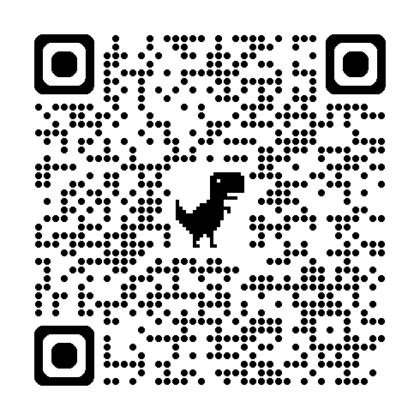
Download Today’s PowerPoint At:
https://docs.google.com/presentation/d/1n0rbVlahC8tJTFb8tH5u84nHWMrulRgY/edit?usp=sharing&ouid=111747465153681153102&rtpof=true&sd=true

Slide 74

Thank You For Attending Today!
Please contact me anytime. I’m here to help.
Mobile: 314-323-7340
bryan@MostValuablePD.com
Twitter @drp_principal

